Slide 2
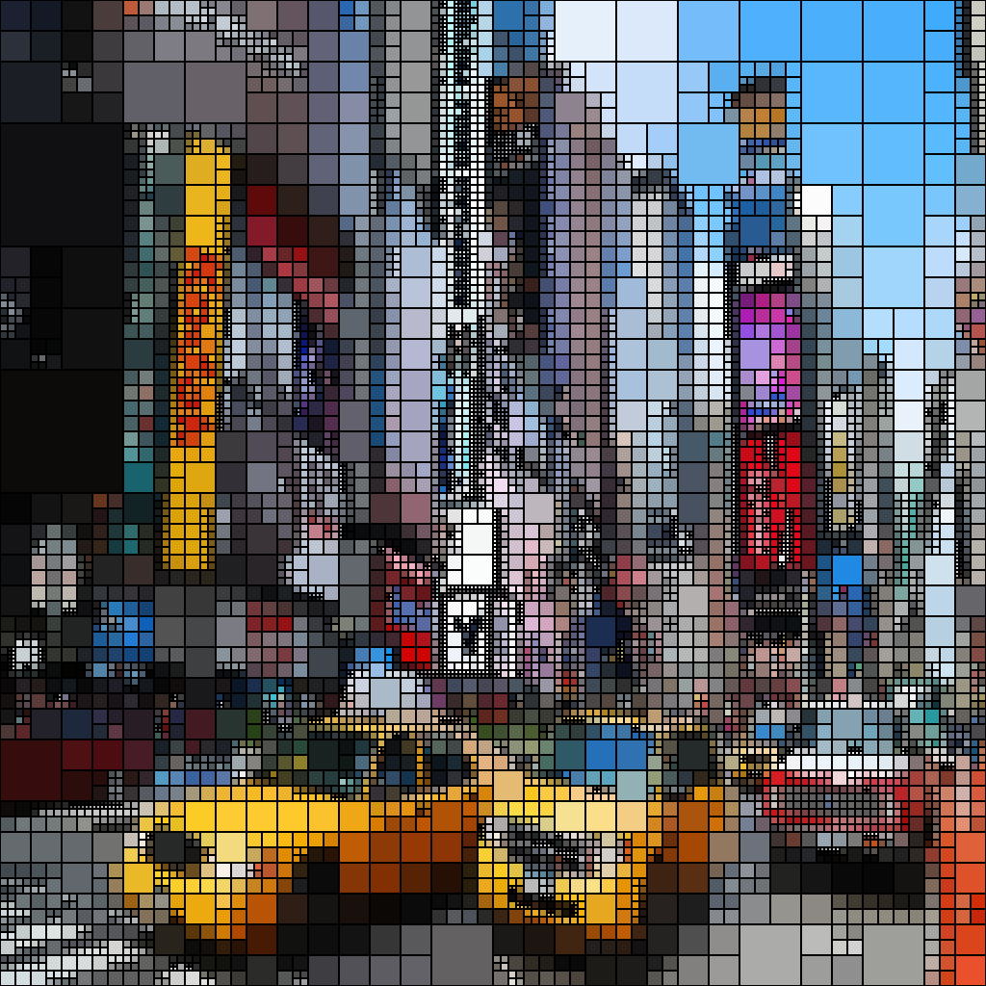
Image Manipulation using Quadtrees
NAME : AMAN TEJWANI
MIS : 112003146
COMP DIV 2
DSA PROJECT

Slide 3

The Algorithm
A quadtree is a tree data structure in which each internal node has exactly four children. Quadtrees are the two-dimensional analog of octrees and are most often used to partition a two-dimensional space by recursively subdividing it into four quadrants or regions. The data associated with a leaf cell varies by application, but the leaf cell represents a "unit of interesting spatial information. Type of image used –PPM (Portable PixMap file format) image A PPM file consists of two parts, a header and the image data. The header consists of at least three parts –�The first "line" is a magic PPM identifier it can be P6.�The next line consists of the width and height of the image as ASCII numbers. �The last part of the header gives the maximum value of the colour components for the pixels, this allows the format to describe more than single byte (0 to 255) colour values

Slide 4
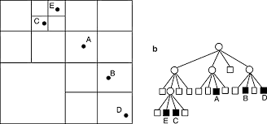
Addition of new color to the Quad-Tree
The QT segments the image into homogenous and heterogeneous parts to allocate fewer bits to homogenous regions and more bits to those regions that contain additional detail and sharper features, which means that specific information embedded in the images, is of high worth than the rest.

Slide 5

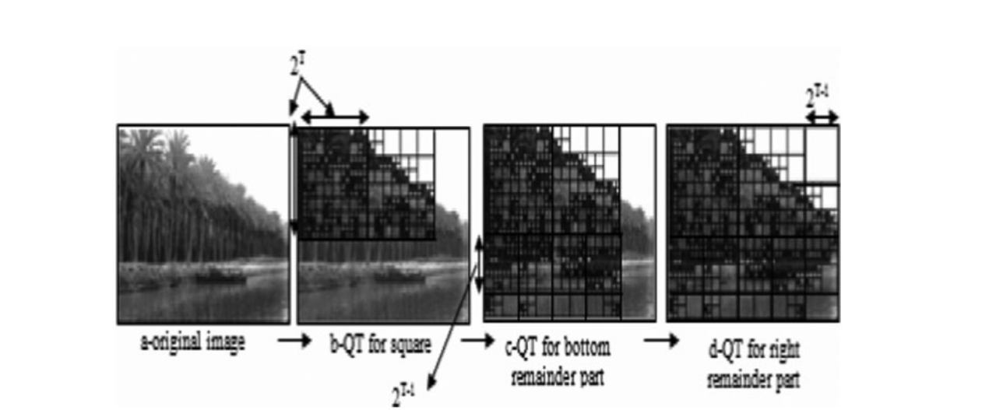
In the QT, a parent node denotes image and its four quadrants are symbolised by four child nodes. The QT comprises of a number of internal nodes and a number of leaf nodes. Leaf nodes correspond to the homogenous/uniform quadrants (one where all the pixels have the same colour), whereas internal nodes correspond to heterogeneous/no uniform quadrants (do not have the same colour in all their pixels; it is an interior node). The size of the QT is directly proportional to the complexity of the images: the more complex the image, the greater the QT size and vice versa. We divide the parent into four leaf nodes until all the leaf nodes have pixels with average color that corresponds to the entered boundary

Slide 6
Commands to run the program
To Run the Program run
make
It contains gcc main.c qt.c –o result
For Compression : ./result -c threshold <input_name> <output_name>
For Mirroring : ./ result –m h or v threshold <input_name> <output_name>
For Overlapping : ./ result –o threshold <input_name1> <input_name2> <output_name>
Changing colour : : ./ result –a colour threshold <input_name> <output_name>
Colour -- red (for red) / green (for green) / blue (for blue) /
grey (for greyscale) / black_white (for black and white)
Threshold is the number in power of two
TO Convert ppm file to png image in linux use convert <name.ppm> <name.png>

Slide 7


Results
Compressed Image
Original Image

Slide 8


Flipped Image
Grey Scaled Image

Slide 9
References
Portland State University PDXScholar
Quadtree-based processing of digital images by Ramin Naderi Portland State Universit
IEEE research papers
http://www.elseviercomputerscience.com/
(Enhancements of partitioningtechniques for image compression)
https://www.kdnuggets.com/2019/12/convert-rgb-image-grayscale.html
Etc…………..

